Slide 1
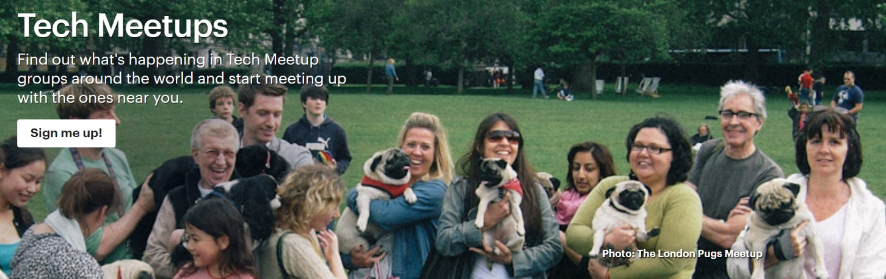
Tech Group Meetups
Kenny Moy

Slide 2


What kind of tech communities are out there?
What are they talking about?
How have they Evolved?
Is there Anything I should know?
?
?
?
?

Slide 3
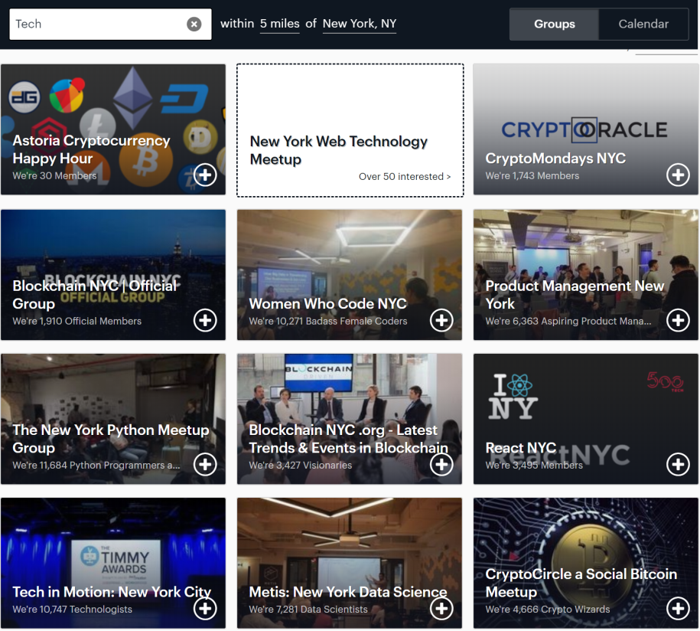

Methodology
Used Selenium for scraping
Starting URL: https://www.meetup.com/find/tech/
Defaulted to a 5 mile radius of New York, NY
Click the ‘Show More’ button repeatedly with while loop until it was no more
Grab the href from every anchor tag from each group and store it as a list

Slide 4

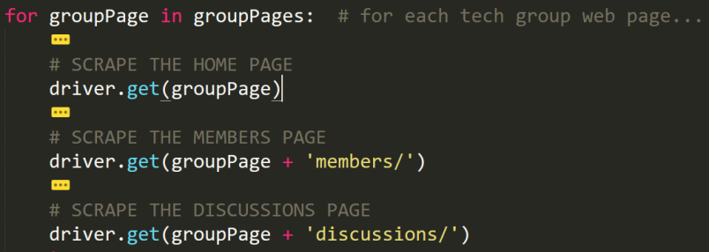
Methodology Contd.
Iterating through the list of main pages with a for loop, I used driver.get() for each of the sub-pages (circled in red) by simply appending to the url

Slide 5
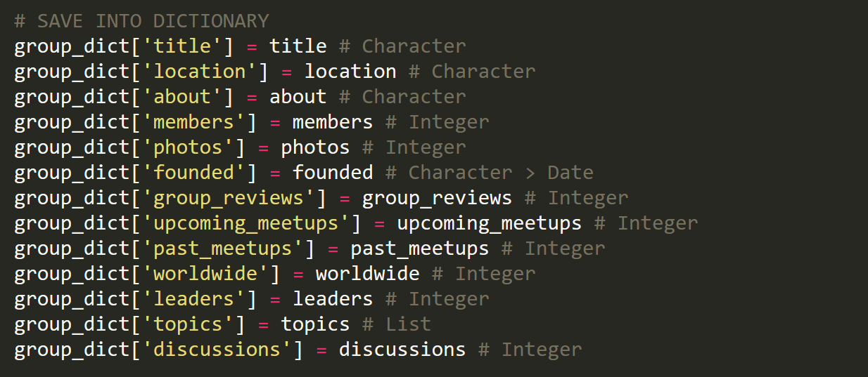
Scraped Data

Slide 6
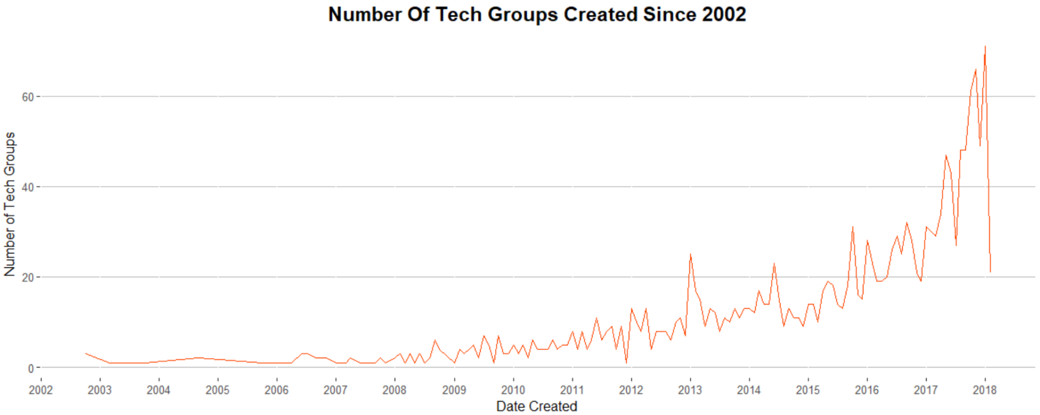
Peaks in 2013 and 2017 For Tech Groups Created
2017: ‘Cryptocurrency’ and ‘Blockchain’
2016: ‘Open Source’
2015: ‘Open Source’
2014: ‘Big Data’
2013: ‘Tech Startups’ and ‘Big Data’

Slide 7
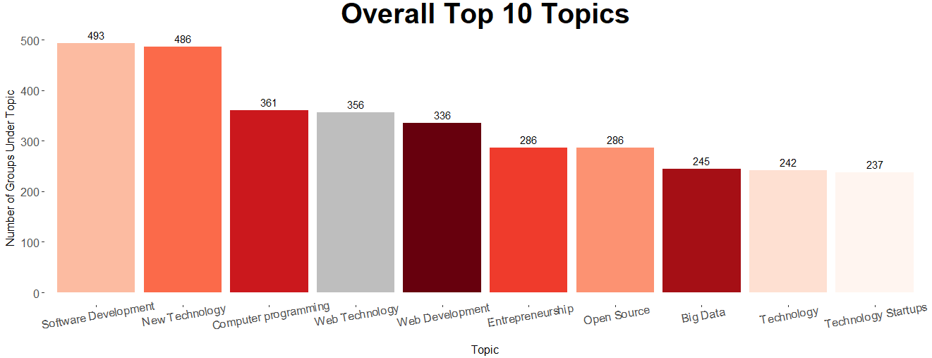
‘Big Data’ Ranks 8th Overall Topic

Slide 8
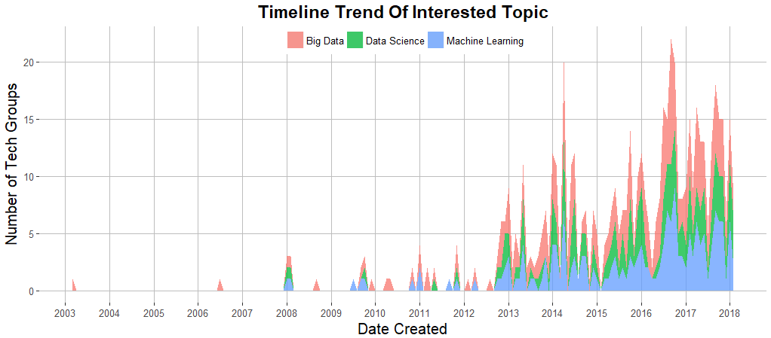
3 Topics Spike in 2014 and 2016

Slide 9
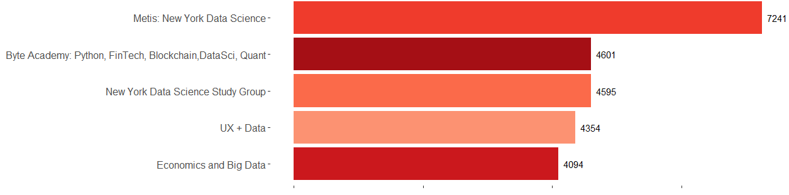
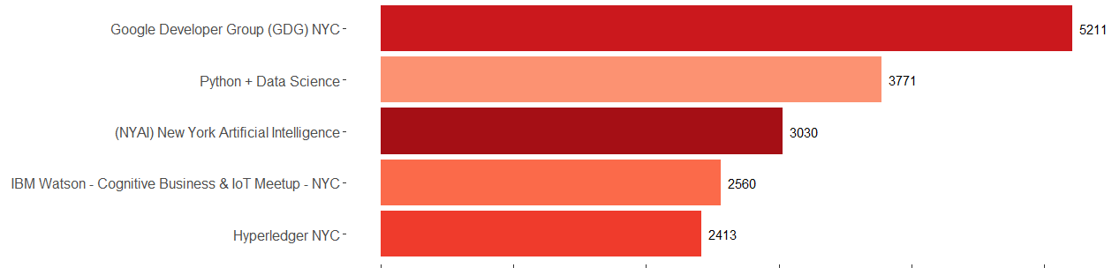
Top Groups Ranked By Member Size
Top 2014
Topics
Top 2016
Topics

Slide 10

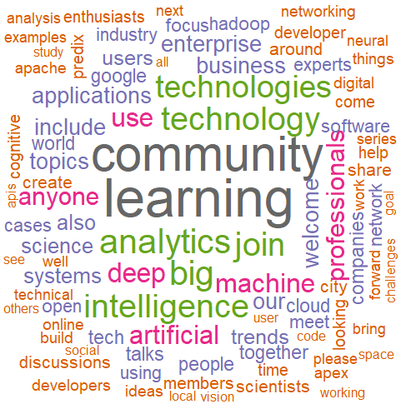
Most Frequent Words Used In Their ‘About’ Page
2016
2014

Slide 11
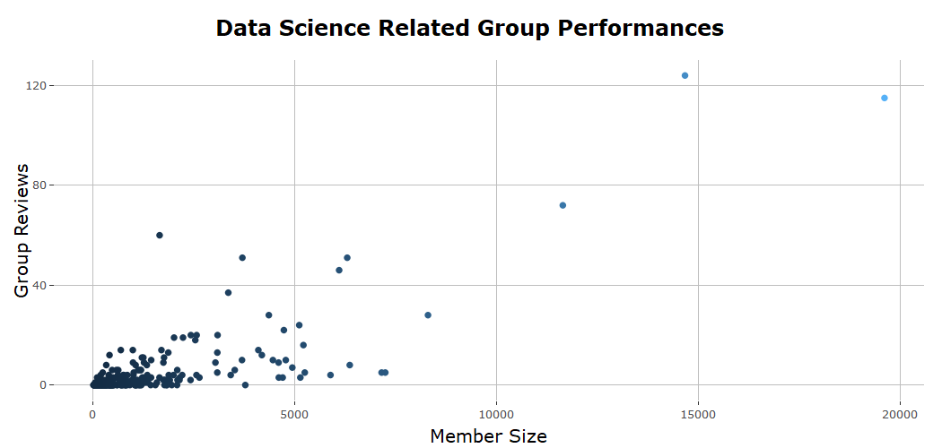
Meetup Recommendations?
SQL NYC, The NOSQL & NewSQL Database Meetup
Members: 19,618
Reviews: 115
Data Driven NYC (a FirstMark Event) Members: 14,672
Reviews: 124
NYC Machine Learning
Members: 11,643
Reviews: 72

Slide 12
I Learned...
Too many topic label variations that mean the same thing
Meetup should standardize them so recommendation systems can be easier
A bit of a history lesson
Popular Meetup groups that I can join
Scraping Event information will provide better insight to tech community interests

